Slide 1
STLC of Student Management System
Presented To
Tasniya Ahmed
Lecturer, IIT, NSTU
Presented By
Nowal Benta Basher
Md. Abrar Hossain
1
2/20/22

Slide 2
Contents
Software Life Cycle
Phrase 03[Test Case Development]
Introduction
Phrase 04: Environment Setup
Phase 1[Requirement Analysis]
Phase 5 [Test Execution and Bug Reporting]
Phrase 02[Test Planning & Strategies]
Phase 6[Test Cycle Closure]
2/20/22

Slide 3
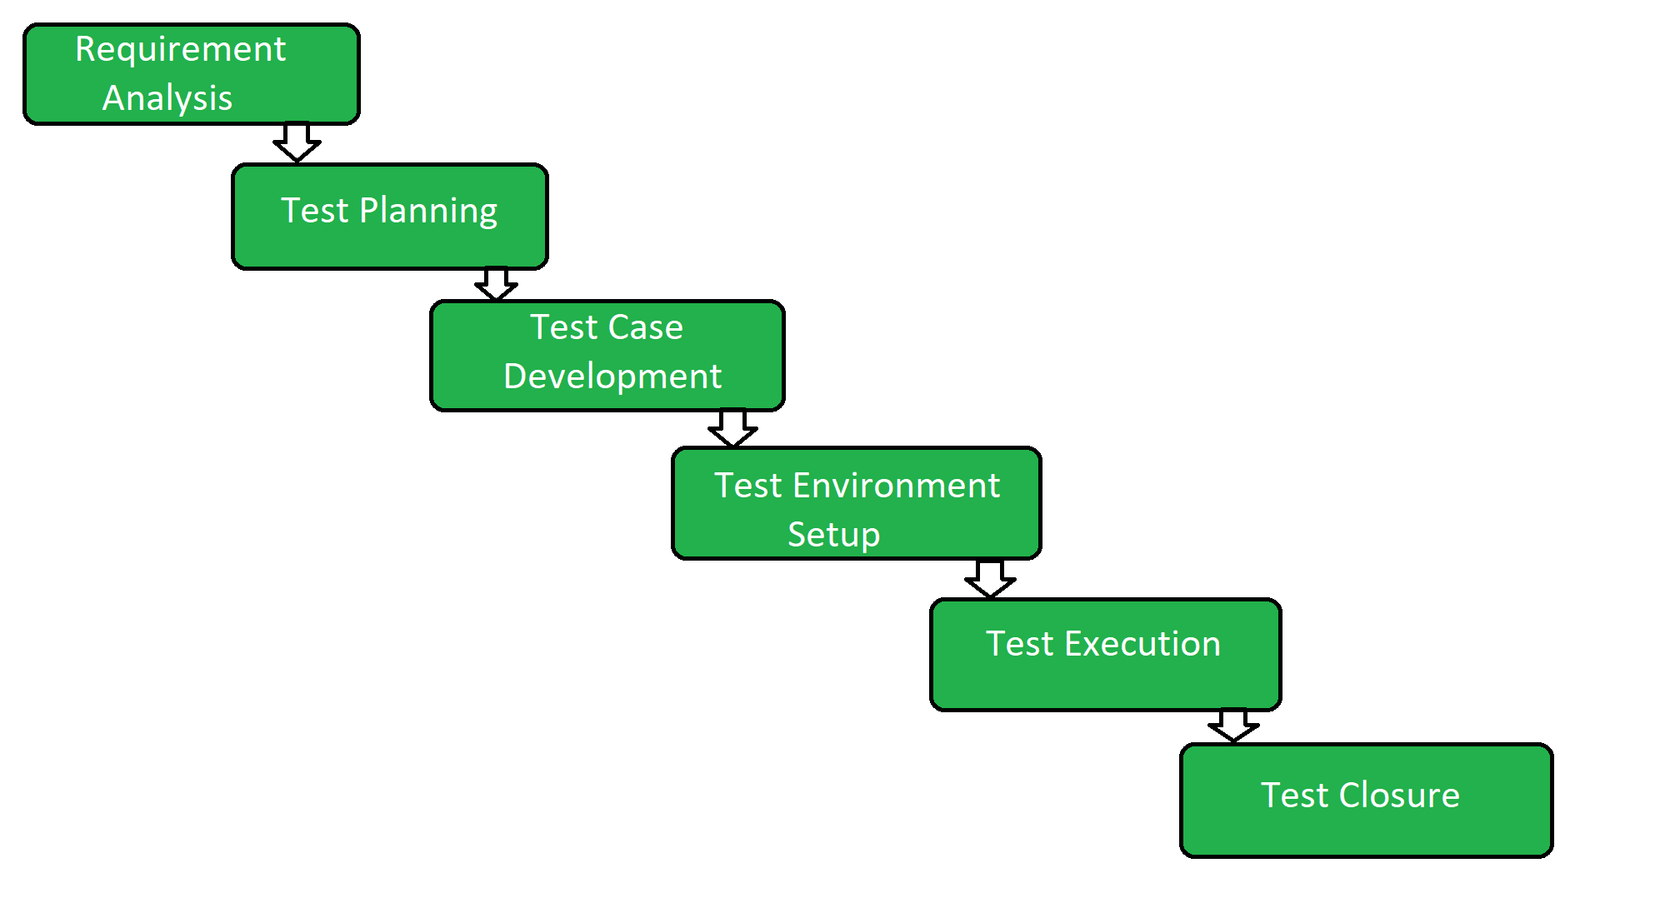
SOFTWARE TESTING LIFECYCLE [STLC]
Software Testing Life Cycle is a testing process which is executed in a sequence, in order to meet the quality goals. It is not a single activity but it consists of many different activities which are executed to achieve a good quality product. There are different phases in STLC which are given below:
2/20/22

Slide 4

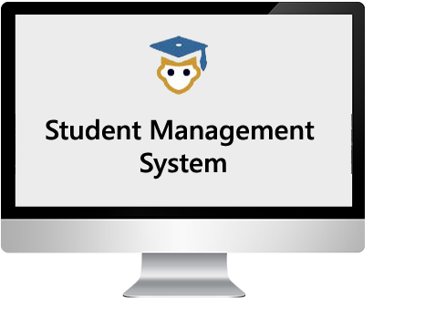
Introduction
Student Management System (SMS) is software application for the education that can be used to managed student information and data. Student Management System manages student information like
Student List
Registration of new Student
Student attendance
Student CT exam marks
Student Results
Class routine
2/20/22

Slide 5
Phase 1[Requirement Analysis]
This is the very first phase of Software testing Life cycle (STLC). In this phase testing team goes through the Requirement document with both Functional and non- functional requirements details in order to identify the testable requirements.
From our Project, Functional Requirements:
Add new session
View sessions
Register new student
View students
Add CT exam result
View CT exam result
Add final exam result
View final exam result
Add class routine
View class routine
List student’s session wise
List CT result by session, term, course code
List final exam result by session, year, term
List class routine by year, term
Provide template for ct exam, final exam, class routine.
View individual student information
View recent activities done by the user
2/20/22

Slide 6
Phase 1[Requirement Analysis]
Non-functional requirements:
Student id and email should be unique
Student info such as id, name, session, email, personal mobile number, parent mobile number, gender data must need to be filled up.
Student address and date of birth are optional input data.
Class routine, CT exam, Final exam result document must need to be in CSV (comma separated value) format.
Class routine, CT exam, Final exam result document must need to be within 10 MB size.
Track and store only when registering new student, adding session, adding CT exam result, adding final exam result, adding class routine.
2/20/22

Slide 7
Phase 2[Test Planning & Strategies]
Test Planning phase starts soon after the completion of the Requirement Analysis phase. In this phase, prepare the Test Plan and Test Strategy documents.
Unit Testing
Integration and System Testing
Performance Testing
Regression Testing
2/20/22

Slide 8
Phase 3[Test Case Development]
In this phase we write test cases. Creation of Test Data is done in this phase.
Test Case ID | Test scenario | Test steps | Test data | Expected results | Actual results | Pass/Fail
TC05 | Check teacher list information | 1. Click on Teacher navigation item. | Not applicable | User should see a new page with list of teachers in table format. | As expected | Pass
TC18 | Check existing final exam result | 1. Click on ‘Final result’ drop down from the navigation bar. 2. Click on ‘View final result’ 3. Select session, year, term from the list. 4. Click on ‘Submit’. | Session: 2017-2018 Year: 1 Term: 1 | A table with list of students and list of courses will show associated with the selected session, year and term. | Nothing is showing | Fail
2/20/22

Slide 9
Phase 4 [Environment Setup]
This phase includes the setup or installation process of software and hardware which is required for testing the application.
Hardware: Dual Core or above machines
Software: Microsoft Windows XP installed
2/20/22

Slide 10
Phase 5 [Test Execution and Bug Reporting]
Before starting the Test Execution phase the Test Environment setup should be ready. In Test Execution phase the test cases are executed in the testing environment.
Scenarios | Complexity | Responsible tester | Date of Execution | Status (Pass/Fail) | Bug Id | Severity | Status
View CT exam Result | Medium | Asif | 2/17/22 | Pass
Add final exam result | Complex | Saima | 2/17/22 | Fail | 1001 | High | Adding Fail
Add Class routine | Complex | Saima | 2/18/22 | Pass
Provide template for final exam | Complex | Asif | 2/18/22 | Fail | 1004 | Complex | Can’t provide template
2/20/22

Slide 11
Bug Report
Specific report that outlines information about what is wrong and needs fixing with software or on a website.
While execution of the test cases the QA team may find bugs which will be reported against that test case. This bug is fixed by the developer and is retested by the QA.
01.Bug Name: Add final exam result
Bug Id: 1001
Expected Result: Adding Successfully
Actual Result: Can’t add the final result
Build Version: 1.0
OS: Windows 10
Severity: High
Priority: High
02.Bug Name: View final exam result
Bug Id: 1002
Expected Result: View Successfully
Actual Result: Can’t view the final result
Build Version: 1.0
OS: Windows 10
Severity: Medium
Priority: Medium
2/20/22

Slide 12
Phase 6[Test Cycle Closure]
In order to start the Test Cycle Closure activity, the Test Execution phase should be completed. In Test Cycle phase the QA team will meet and discuss about the testing artifacts.
Test Cycles | Number of Test Cases | Test Case Executes | Test Cases not execute | Test Cases Pass | Test Cases Fail
Cycle 01 | 8 | 8 | 0 | 6 | 2
Cycle 02 | 10 | 10 | 0 | 8 | 2
Cycle 03 | 8 | 8 | 0 | 6 | 2
Total | 26 | 26 | 0 | 20 | 6
2/20/22

Slide 13
THANK YOU!!
2/20/22

